Slide 1

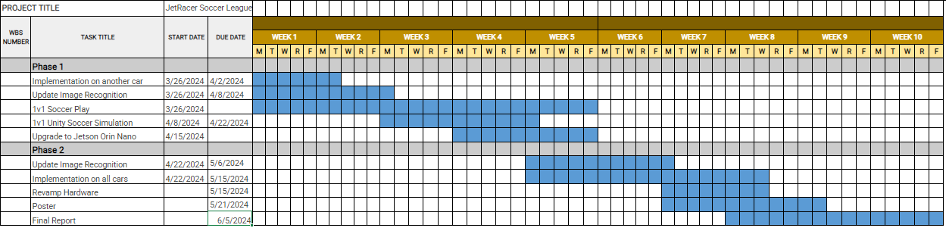
Overview
JetRacer Soccer Jarod Marshel, Casey Rittenhouse, Arjun Simha, Mason Kang, K Gupta, Julie Ham, Cooper Ritter
Overall Concept:
Overall Project Deliverable | Progress
Basic Movement | Done
Image recognition | Done
New sensor implementation | In progress
Object following/Ball Striking | In progress
Versus and Strategy | In progress
Github with documentation | In progress
Summary and report | In progress
New Sensor
Project is On Schedule
Gantt Chart/Schedule

Slide 2
Short-Term
JetRacer Soccer Jarod Marshel, Casey Rittenhouse, Arjun Simha, Mason Kang, K Gupta, Julie Ham, Cooper Ritter
Previous Meeting Action Items:
Item | Description | Owner | Target Date | Status
1 | Build field for cars | Jarod | Feb 19 | Done
2 | Unity soccer simulation training | Mason | Jan 31 | Done
3 | Object following | Everyone | Mar 8 | Done
4 | Implement new sensor onto car | Everyone | Mar 11 | Done
5 | Preliminary Design Review | Everyone | Mar 12 | Done
6 | Retrain Object Detection | CV team | April 15 | In Progress
7 | 1v1 Soccer | Everyone | May 1 | Not started
Biweekly Action Items:
Item | Description | Owner | Target Date | Status
1 | Retrain Object Detection | CV team | April 15 | In Progress
2 | 1v1 Soccer Logic | Not assigned | May 1 | Not started
3 | Set up software on cars | Casey | April 20 | In Progress
4
5
Significant Roadblocks/ Non-developing Items:
Budget:
Jetson Orin conflict ZED SDK version conflict
Total Proposed | Plan to Date | Used to Date | Used Vs Plan
$3500 USD | $1450 USD | $650 USD | +$1400 USD
Short Term Schedule:
Request for teaching staff:
Apr - May |  |  |  |  |  |  |  |  |  | Feb
21 |  |  |  |  | 28 |  |  |  |  | 5
Test new YOLOV8
Start upgrade to Orin

Slide 3
Team Progress

Slide 4
ROS/Hardware (Cooper and Arjun)
JetRacer Soccer Jarod Marshel, Casey Rittenhouse, Arjun Simha, Mason Kang, K Gupta, Julie Ham, Cooper Ritter
Previous Work:
Integrated rospy with roscpp structure
Got I2C communication (for servo control) working on Jetson
Developed PID controller for ball tracking
Fixed ZED calibration file issues
Future Work:
Fine-tune ZED PID controller
Fix bugs
Improve tracking
Implement search/scan function when ball is lost
Print updated car parts

Slide 5
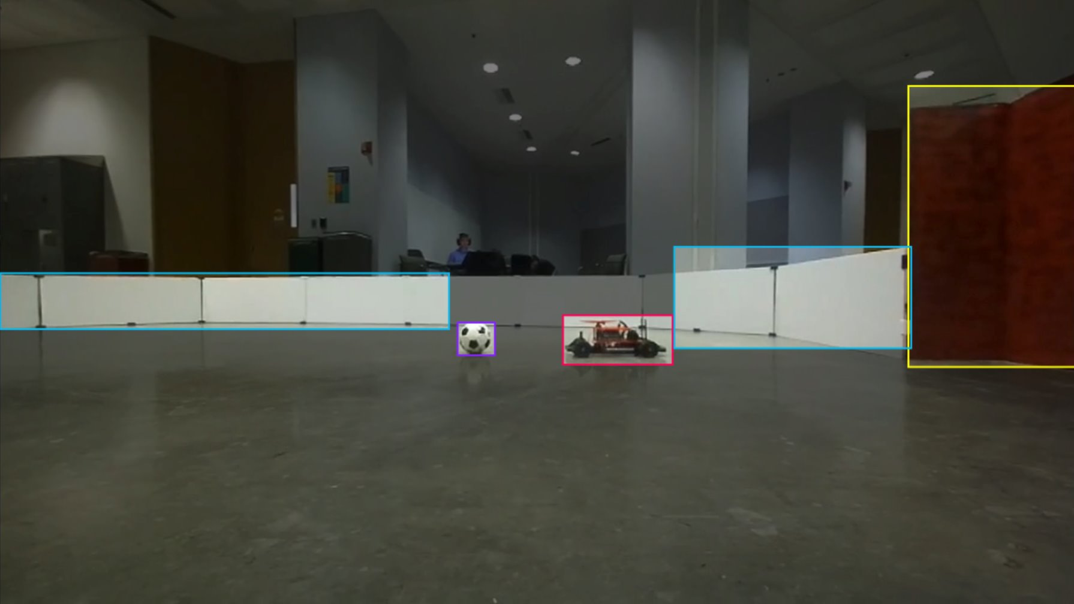
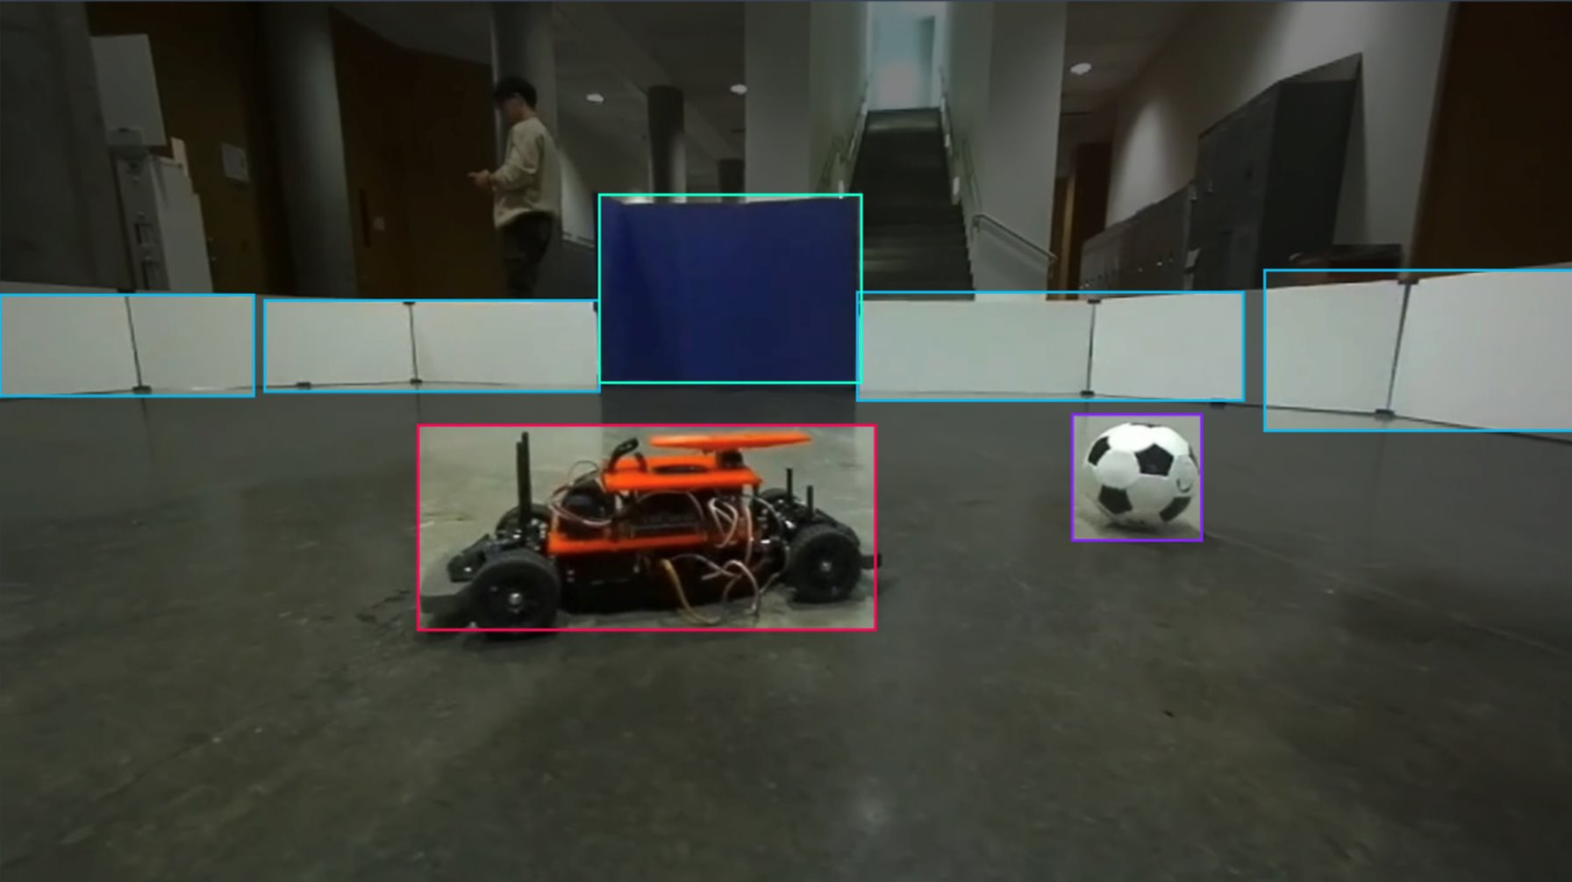
CV/Image Recognition (K and Julie and Jarod)
JetRacer Soccer Jarod Marshel, Casey Rittenhouse, Arjun Simha, Mason Kang, K Gupta, Julie Ham, Cooper Ritter
Previous Work:
Issues running object detection with ZED on laptops- need to run on Jetson
Future Work:
Update object recognition to include classification for blue car

Slide 6
Software/Strategy (Casey and Mason)
JetRacer Soccer Jarod Marshel, Casey Rittenhouse, Arjun Simha, Mason Kang, K Gupta, Julie Ham, Cooper Ritter
Previous Work:
Worked on developing movement strategy
Developed strategy for camera and steering movement
(Including basic 1v0 and ball intercepting strategy)
Began migrating code from unity
Future Work:
Continue to refine movement strategy
Implement on car once hardware team is finished

Slide 7
Team Roles
Project Manager - Jarod
Point of Contact - Arjun
Budget Manager - Casey
ROS/Hardware Team:
Cooper, Arjun,
CV/Image Recognition Team:
K, Julie, Jarod
Software/Strategy Team:
Casey, Mason

Slide 8
Previous Year's Work
Built and gained full range of motion of 4 JetRacers using software
Set up a simulation environment to virtually train the agents
Structured a reward system for the reinforcement learning model
Implemented object detection model that identifies a soccer ball, opponent, and goal
Implemented software to follow and strike a ball
Developed logic process for striking a ball into a goal
Simulation results with reward structure demonstrate that agents can be trained to efficiently compete in a 2v2 soccer match
Created a GitHub page documenting the hardware and software instructions to setup JetRacers, a summary of the work completed, and plans for future work

Slide 9
Our Final Deliverables
Demonstrate basic motion of JetRacer: 01/2024
Demonstrate JetRacer Image Recognition for soccer play: 01/2024
Trade study of possible sensor additions: 02/2024
Preliminary Design Review: 02/2024
Showcase vehicle scoring soccer ball in the goal in real-world: 03/2024
Add additional agents in the real world: 04/2024
Final Data Review: 05/2024

